Slide 1

Cross-Lingual Document Retrieval using Embedding Models
Group Number 10:
Atishay Kasliwal - 116373667
Meet Zalavadiya - 116644121
Moraish Kapoor - 116793038
Shaunak Rahul Mahajan - 116553078
Swati Swati - 116778659

Slide 2
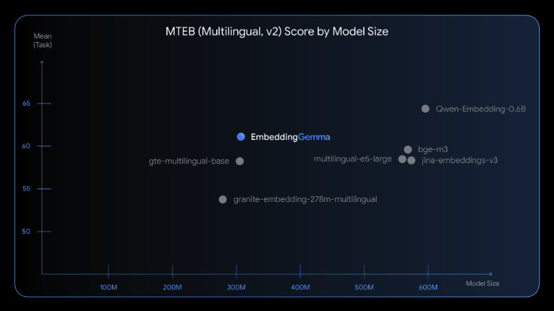
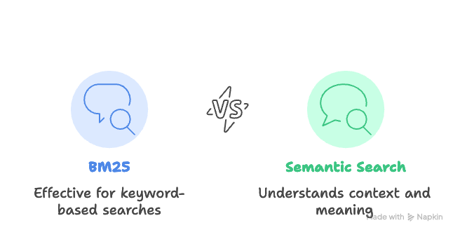
Background
Objective
Computers are good with numbers, but humans are good with text.
Web is multilingual, but search engines still favor English → cross-lingual queries fail.
Wikipedia (300+ languages) is a rich multilingual knowledge base.
Embeddings are a way to convert this text into numbers.
AI for Multilingual Semantic Search
Build a system for multi-lingual retrieval:
Query in any language (English/Hindi/Spanish).
Retrieve relevant documents regardless of their source language.
Approach:
Use EmbeddingGemma to generate multilingual embeddings.
Store in a vector DB for semantic search.
Optionally use Gemma-3n for summarization/translation of results.

Slide 3
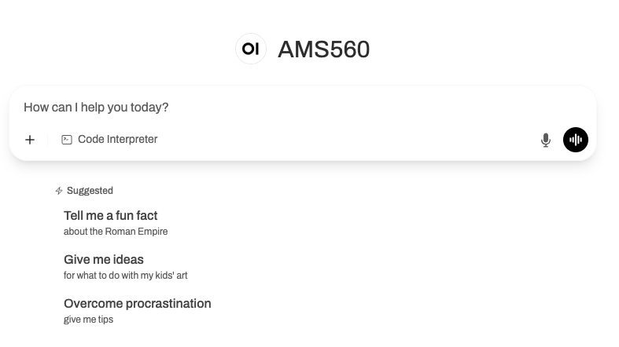
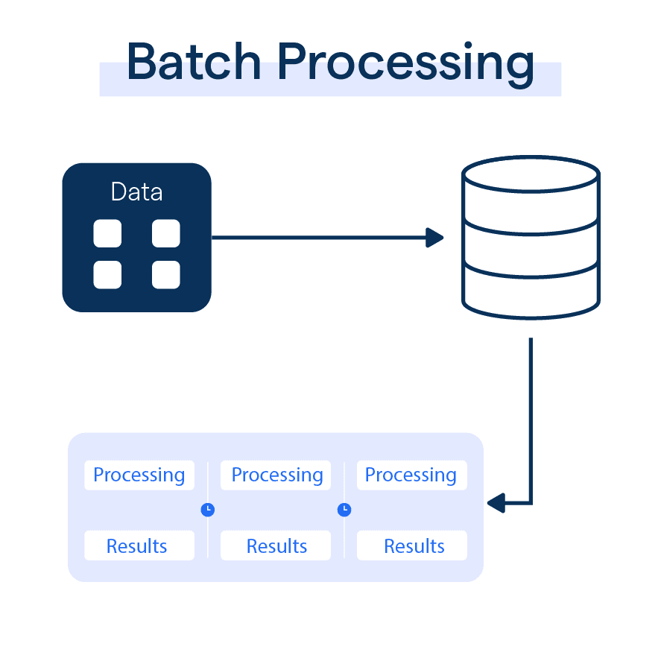
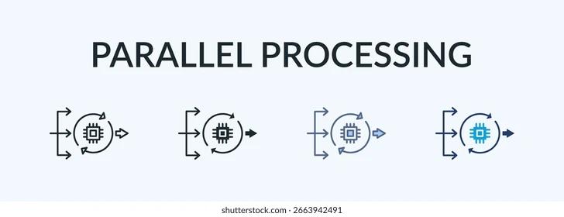
Deliverables
Used to embed documents across multiple languages.
To handle multiple user queries and requests.
Chat interface to interact with the embedded wiki database.
Timeline
Phase 1
Set up the vector database & complete the initial Embedding runs
Project Proposal
Today: Project Presentation
Final Submission of Project
Report and Project demo. Result analysis.
28th Sept
31st Oct
23rd Sept
15th Oct
End of November
Report Submission
Providing a high level project plan along with the technologies used.
Phase 2
End to end pipeline to ingest data, defining evaluation metrics.

Slide 4
Thank You!

